Slide 1
Presence of Opioids in Wastewater
Drew Gobbi, Olivia Wang, Olatunji Akinbule, Maddie Warndorf
Conclusion Validity

Slide 2
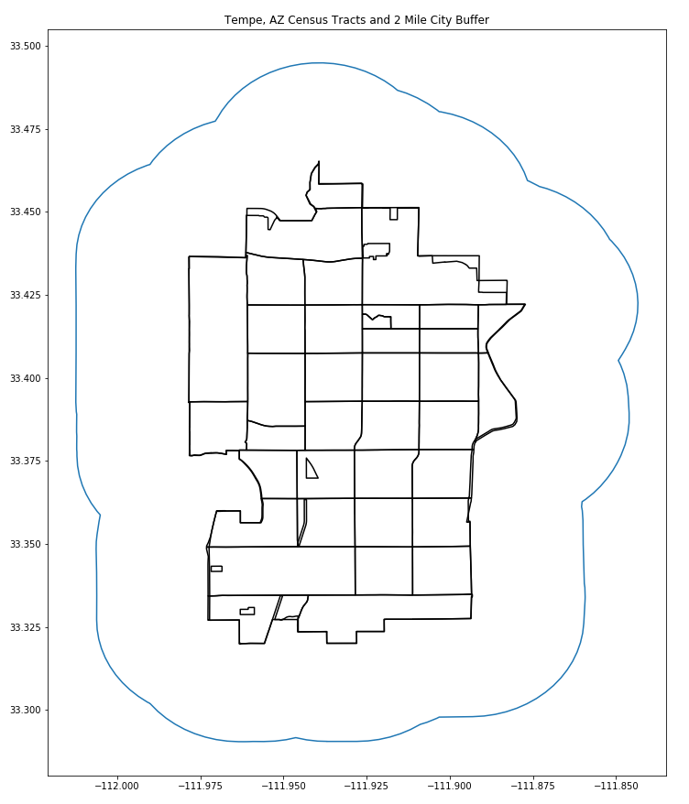
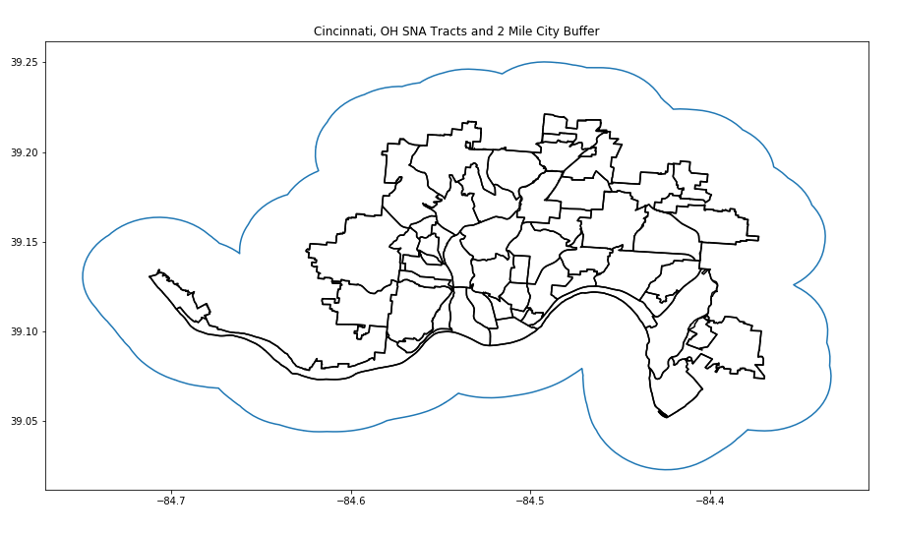
Description of Independent Variables
We select independent variables that represent the location of public health interventions across cities that could have an impact on the number of drug users in a given area (Tempe, AZ and Cincinnati, OH). Each independent variable was counted by being within 2 miles of selected spatial unit. For Tempe it is by census tract and for Cincinnati it is by Statistical Neighborhood Approximations (SNA).
Independent Variables:
Medical Facilities within 2 miles of each spatial unit
Pharmacies within 2 miles of each spatial unit
Drug Drop off Locations within 2 miles of each spatial unit
Naloxone Distribution Centers within 2 miles of each spatial unit

Slide 3
Dependent Variables, and the Relationships
Dependent Variables
Count of EMS Calls
Count of calls by each month in each year for each spatial unit.
Used for Tempe and Cincinnati.
Average Population Normalized Mass Load (PNML)
Average PNML per site collection area per month per year.
Used only for Tempe
We expect the spatial predictors we have included to have varying degrees of impact on our constructs of opioid use both in terms of magnitude and direction.
Relationships:
EMS Calls vs. Medical Facilities
PNML vs. Medical Facilities
EMS Calls and PNML vs. Naloxone Distribution Centers and Drug Dropoff Centers
EMS Calls vs. Pharmacies
PNML vs. Pharmacies

Slide 4
Relationship Between EMS Calls vs. Medical Facilities and PNML vs. Medical Facilities
EMS Calls vs. Medical Facilities
Expect: The number of medical facilities in an area to be negatively correlated with drug use because treatment is more readily accessible.
EMS calls could be negatively correlated with the number of medical facilities in an area if one believes that they act as depressants on overall drug use and represent treatment centers within an area.
Caveat: However, because of the way our constructs are measured, the actual magnitude and sign of this relationship may not be as well represented.
PNML vs. Medical Facilities
Expect: Medical waste that is dumped at a higher level near these areas may actually show a positive association with the PNML of the opioids in wastewater in an area.
Caveat: We know that there will probably be a positive relationship because of the higher presence of drugs at medical facilities, but we expect these facilities to represent treatment.

Slide 5
Relationship between EMS Call and PNML vs. Naloxone Distribution Centers and Drug Drop off Centers
EMS Calls and PNML vs. Naloxone Distribution Centers and Drug Drop off Centers
Expect: Naloxone distribution centers and drug drop off centers to represent effective treatments that lower the amount of drug use in an area over time.
Caveat: Areas with greater numbers of naloxone distribution centers or drug drop offs may have already had a high number of drug users in them to begin with, which led city officials to install these interventions at a greater rate.
For the purposes of this analysis, we assume these types of treatments are effective and expect our model to detect the hypothesized long term effects of lowering drug use as measured by both EMS calls and PNML measurements in an area in a point in time. If this assumption proves to not hold, we may have to turn to intervention or time-series based (or both) analyses of when these interventions were introduced to understand this relationship.

Slide 6
Relationship Between EMS Calls vs. Pharmacies and PNML vs. Pharmacies
EMS Calls vs. Pharmacies
Expect: Unsure.
We Know
Pharmacies do act as treatment centers for opioids by administering naloxone and providing drug drop off locations (depending on the city or state).
Pharmacies also prescribe and release more opioids into a given area to patients. Having more drugs in an area can be correlated with higher amounts of drug use.
PNML vs. Pharmacies
Expect: Pharmacies will have positive effect on the PNML measurements of opioids in the area’s wastewater.
Because pharmacies may also produce medical waste.

Slide 7


The Statistical or Machine Learning Analysis Used to Determine Whether this Relationship Exists or Not. Justify this Analysis Relative to the Types of Variables
We will conduct two types of analyses (one for the EMS calls and one for the PNML measurements) to accommodate the distribution of our dependent variables.
Our analyses will attempt to determine the effect of the spatial predictors listed above on each drug use measure.
All variables in this study are ratio measures, with the exception of the EMS calls, which we transform into a binary measure.
Because EMS Calls in now a binary (categorical) measure and the spatial predictors are ratio, we plan on using a logistic regression model that resembles:
The spatial predictors in a given area and at a given point in time with the PNML measures are ratios. However, to account for the unobserved heterogeneity between site collection areas and points in time, we need to add fixed effects. These fixed effects are equal to one if a PNML measure occurs in time t or area j and 0 otherwise. The model will resemble the following:
Notes:
TJ
Fix Power law - EMS Calls

Slide 8
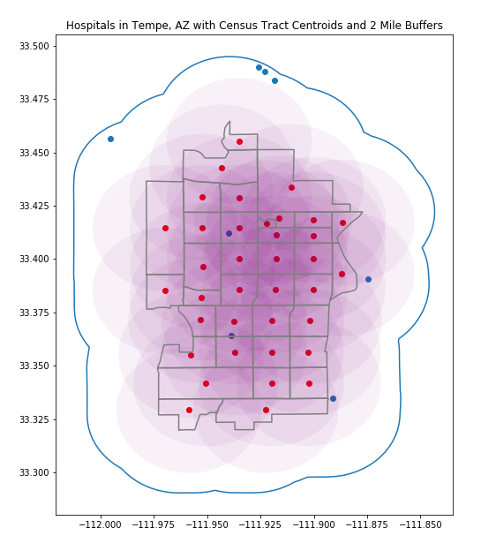
Generate and Clean Pilot Data Reflecting Each of the Variables Identified Above.
EMS Data
The EMS data was counted each spatial unit (either census tract or SNA) and then aggregated by each Year_Month (ex 2017-05).
PNML Data
PNML data is at a different spatial unit (site collection area) than the EMS calls. To get the counts of each spatial predictor in the collection areas, we took the mean of the census tract counts for that predictor for all census tracts that overlapped with the site collection area polygons.
Facility Data
Notes:
Mad

Slide 9
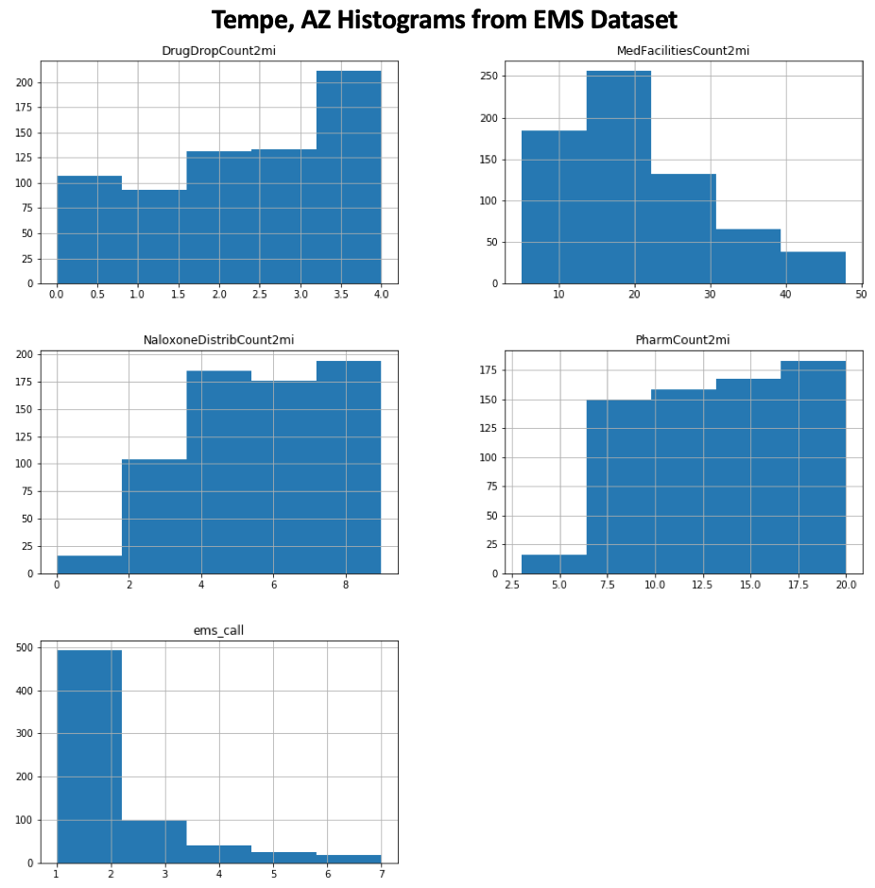
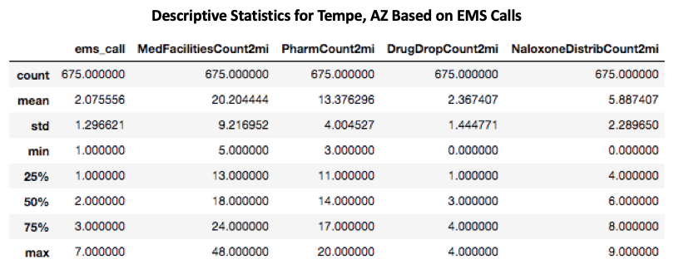
Descriptive Statistics and Histograms of These Data
Notes:
TJ

Slide 10
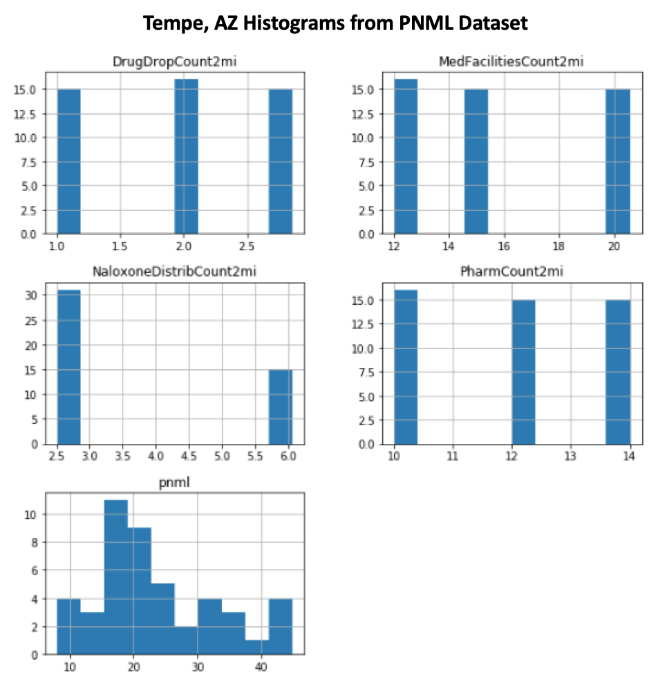
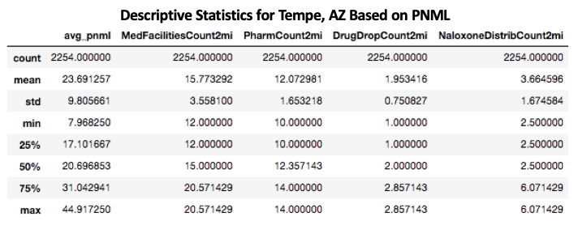
Notes:
TJ

Slide 11
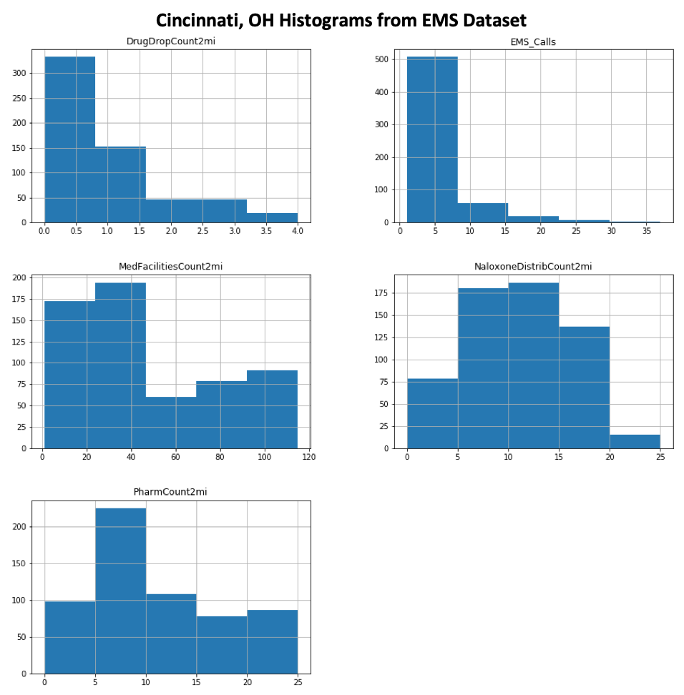
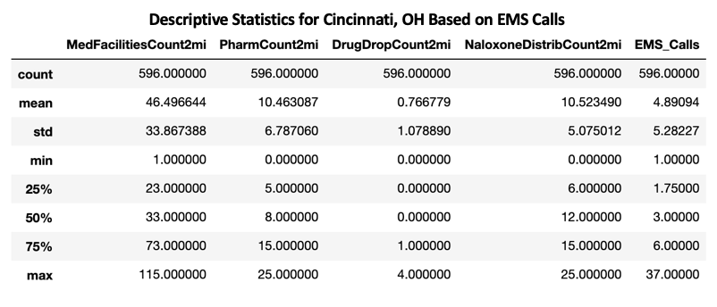
Notes:
TJ

Slide 12
Any Data Transformation is Necessary. Justify the Choice of Transformation.
EMS Calls Data Transformation
We transformed the count of EMS calls per area per year per month to a binary variable.
Equal to 1 if the count of calls is above the series average
Equal to 0 otherwise.
We do this to create two classes of outcomes in our dependent variable that can be analyzed in our logistic regression.
All other variables included in the study are ratio measurements.
While the counts of facilities per spatial area are discrete, we expect their effect on the outcome of interest to vary proportionally to one another. As such, we do not perform any additional transformations at this time.
The PNML measures are somewhat skewed, them to be “Gaussian-like” enough to utilize as is.
Notes:
12

Slide 13
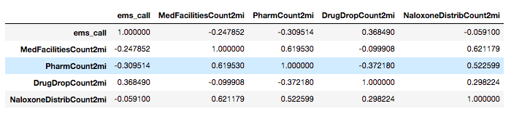
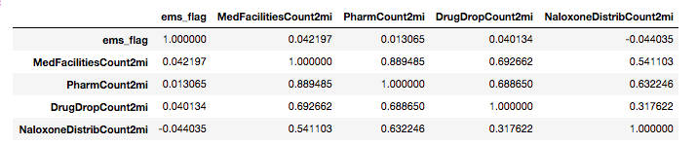
Conduct a Preliminary Test of the Relationships Between Variables of Interest. Justify Choice of this Method Given the Distribution of the Data.
Using Pearson’s correlation for the binary EMS calls indicators and the ratio spatial predictors. Believe there is enough variation in the x axis to due this (but admittedly unsure)
Tempe EMS
Cincinnati EMS
Notes:
M

Slide 14
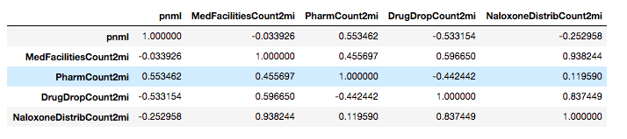
Conduct a Preliminary Test of the Relationships Between Variables of Interest. Justify Choice of this Method Given the Distribution of the Data.
Using Pearson’s correlation for the PNML because the PNML data is approximately gaussian and it and all of the spatial predictors of interest we are looking at are ratio.
Tempe PNML
Notes:
M

Slide 15
How Many Analyses are Planned? Determined Type I Error Rate
Two analyses
1. EMS Calls Logit
2. PNML Spatial linear regression
EMS data has around 500 samples, so will accept a Type 1 error rate at the standard 0.05
PNML data has around 50 samples. Willing to trade off error for a detection effect, and will accept an error rate up to 0.1 or 0.2
Notes:
M

Slide 16
Determined Covariates that We Plan to Control for Statistically and Justification for Them.
Using fixed effects dummy variables in the PNML regression to account for heterogeneity over time and space
Drop one dummy from each fixed effect to minimize multicollinearity issues
Shows the total effect by which tract j at time t differs from another across our sample
Not possible to include these for the logit model because the fixed effects perfectly separates the classes
Will need to obtain possible controls from Census or other sources to minimize confounds
Likely an indicator of what is going wrong in the logit results so far
Notes:
M

Slide 17
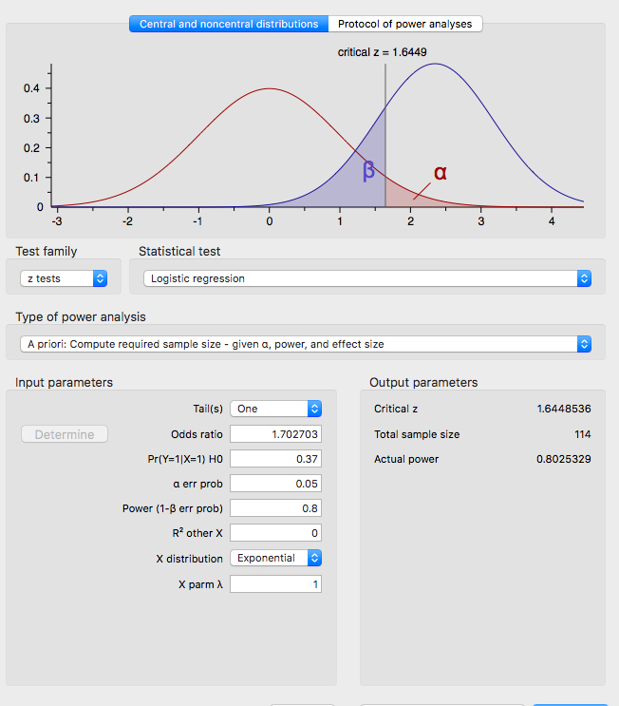
Power Analysis - Logistic Regression
Assumption: At their mean Number of EMS calls per spatial
Area per month will follow average proportions across the dataset
Pr(Y = 1 | X = 1) Null Hypothesis 0.37
Effective proportion of 0.5 against alternative hypothesis odds ratio 1.7027
Critical Z value = 1.67
Minimum Sample = 114
Notes:
DREW

Slide 18
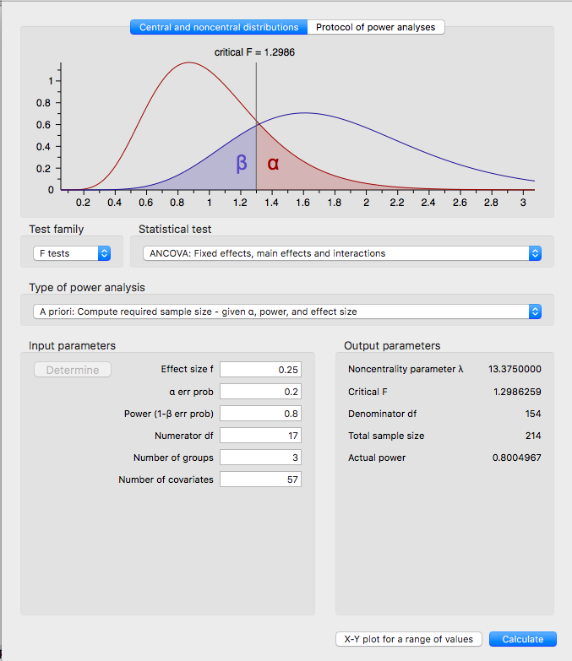
Power Analysis ANCOVA: PNML
37 county level fixed effects + 16 year-month fixed + four regressors = 57 covariates
Using a .2 Type I error rate
.8 desired power,
Results:
Sample size = 154.
About two more years of monthly PNML data collection under the current design.
Notes:
DREW

Slide 19
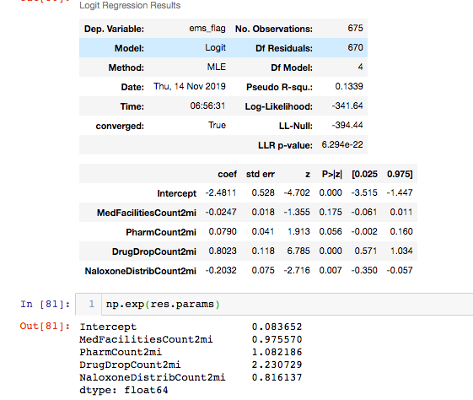
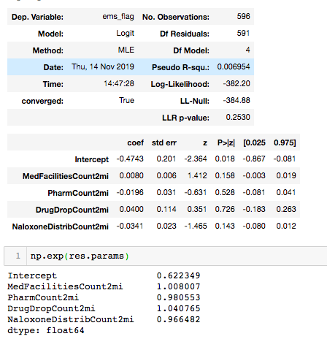
Intended Analysis and Results Regarding the Hypothesized Relationship
Tempe
Cincinnati
Results
Overall - pseudo-R2 low
Tempe
20% reduction in likelihood for Naloxone
Huge increase for drug drop off? Reverse causality?
Cincinnati
No significant Relationship
Notes:
DREW

Slide 20
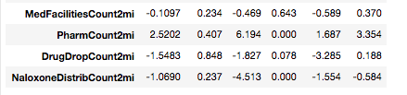
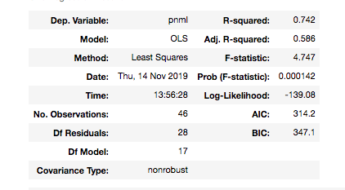
Intended Analysis and Results Regarding the Hypothesized Relationship
Tempe
R2 ~ .742 despite low sample size
¾ relationships are significant
Different results than EMS
Naloxone, Drug Drop -
Pharm +
Notes:
DREW

Slide 21
Overall Summary
Do public health interventions, treatment facility locations, demographics, economic indicators, or other theorized predictors lead to higher incidences of drug use in the given area?
This is deliberately vague - no consensus in the literature, and we are trying a lot of different relationships
Using flawed but available constructs of Opioid Usage (purposive sampling)
Number of EMS Calls per area per month per year
Average PNML in wastewater per area per month per year
We have tested two theories so far:
1. Do poverty status and middle age correlate with higher opioid use?
2. Do the locations of middle age relate to higher opioid use?
Notes:
DREW

Slide 22
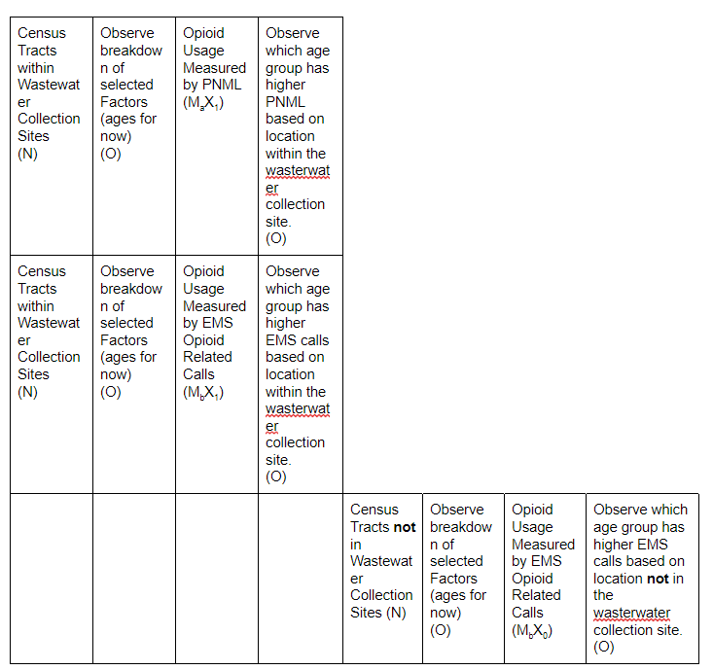
Overall Summary
Using patched up, equivalent materials design to compare the same relationships across different opioid use constructs and cities
Goal: Show that the same relationship holds across each scenario
Stopping short of claiming causality...
...but hope that showing a persistent relationship can lead to future randomized controlled trials or more direct intervention analyses of causal impact
Notes:
DREW

Slide 23
Questions?
Notes:
DREW

